Slide 1
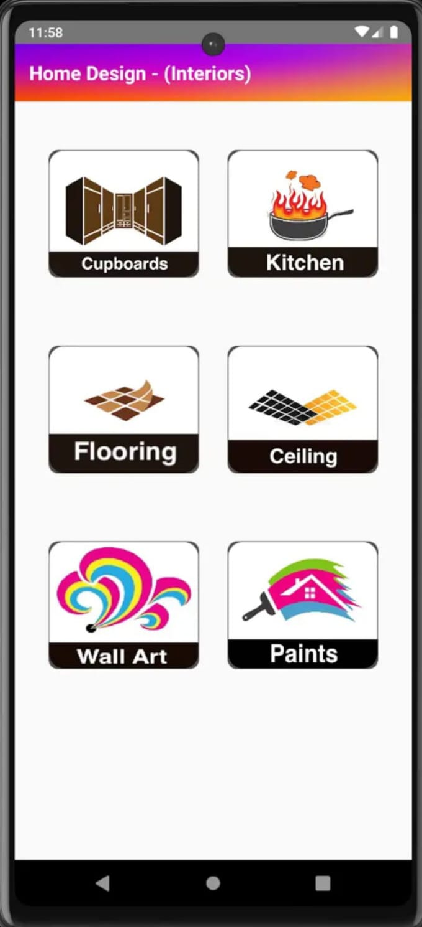
An Android Based Application For Revolutionizing Home Design
BATCH- IT-1
K.V. Hemanth -207Z1A1225
Sheldon Shaji -207Z1A1241
V.Nikil -207Z1A1248

Slide 2

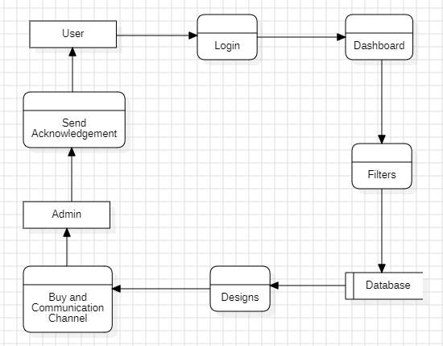
Data Flow Diagram

Slide 3
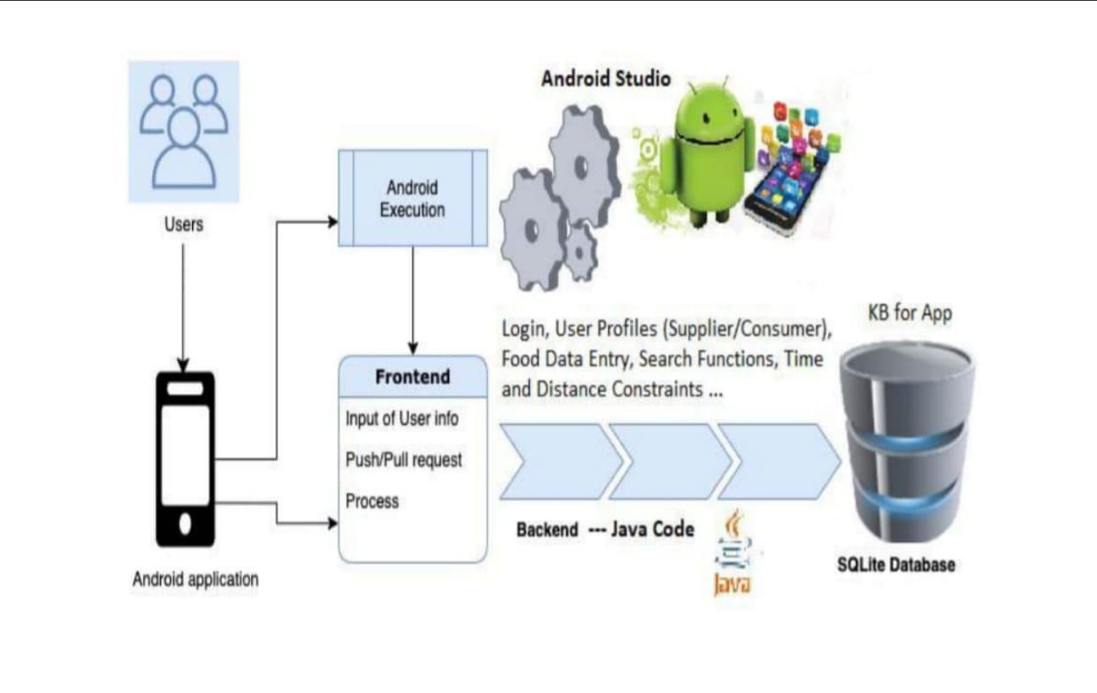
Architecture

Slide 4
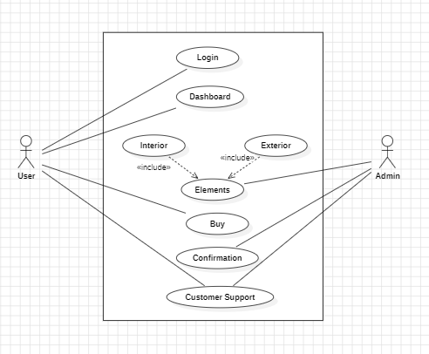
UML DIAGRAMS
Use Case Diagram

Slide 5
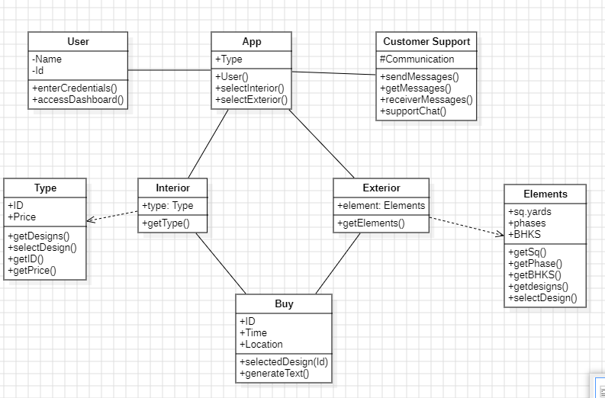
Class Diagram

Slide 6
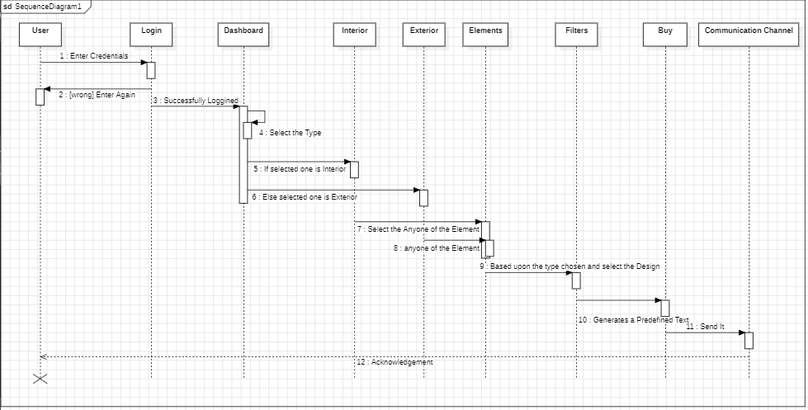
Sequence Diagram

Slide 7
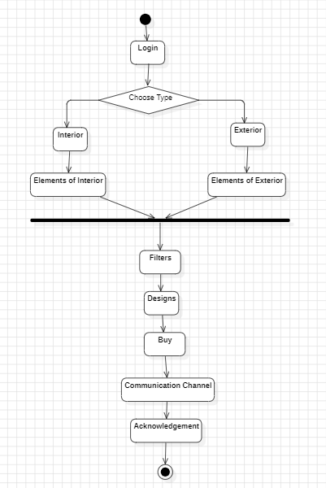
Activity Diagram

Slide 8
THANK YOU

